Slide 1
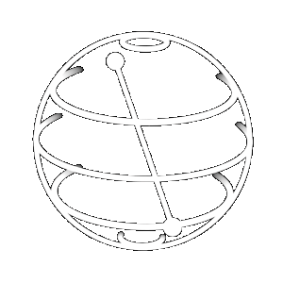
Mirko Amico

Slide 2
Learning quantum mechanics with IBM Q
Mirko Amico
The Graduate Center, The City University of New York

Slide 3
OUTLINE
Quantum mechanics
Computing with quantum mechanics
Qiskit: the language of quantum machines
Quantum experiments in the cloud

Slide 4
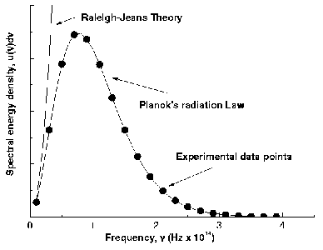
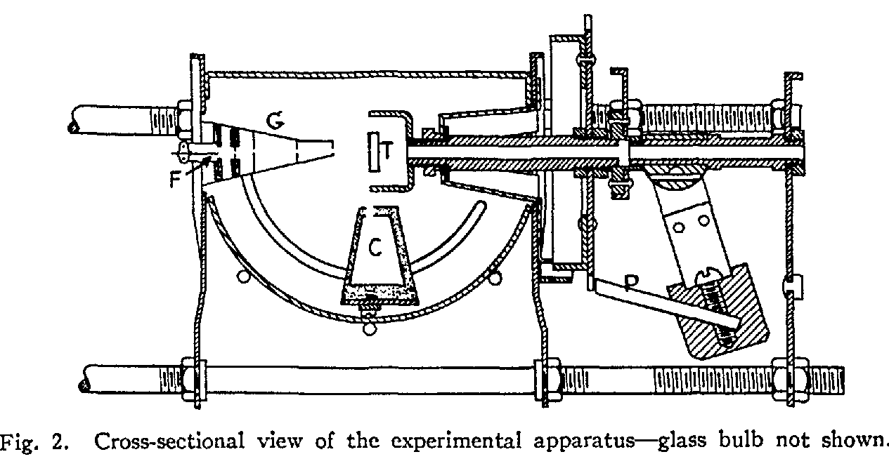
1. Quantum mechanics
The experimental facts discovered at the beginning of the 20th century about the microphysical world (atomic scale) forced us to revise our intuition about reality.
Image from: http://psi.phys.wits.ac.za/teaching/Connell/phys284/2005/lecture-02/lecture_02/node2.html
Image from: Davisson and Germer, Physical Review 30, 705 (1927)
The mathematical framework needed to consistently describe these experiment was soon developed by Heisenberg (1925) and Schrödinger (1926) but their meaning in terms of properties of physical reality is still up for debate.
Several interpretations have been proposed to make sense of the strangeness of quantum mechanics, none of which has won the consensus of the physics community

Slide 5
1. Quantum mechanics
What microphysics is telling us through quantum mechanics is:
1. Physical properties of the reality are discrete: phase space has a minimal volume given by Planck’s constant. We cannot know them with a higher precision.
2. We cannot make certain predictions of the future: at best, we can predict probabilities.
3. Properties of system are brought out when measured, or better, they manifest through interaction.

Slide 6
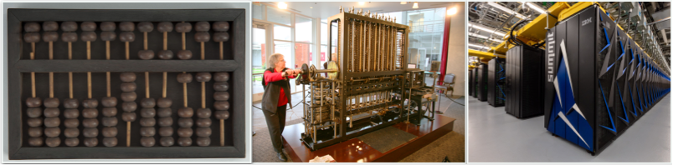
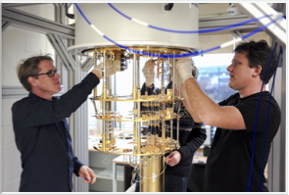
2. Computing with quantum mechanics
Computing means carrying-out a mathematical calculation involving a pre-defined sequence of steps.
Because of the standardized way a computation works, this can be done by a machine.
Images from: http://www.electronic-recycling.ie/wp-content/uploads/2013/06/Chinese-abacus.jpg
https://www.flickr.com/photos/40648743@N00/sets/72157623284316506/
https://www.technative.io/wp-content/uploads/2018/09/Summit-ONL.jpg
Today, we are able to manipulate quantum mechanical objects in a predictable manner and use them as quantum computational machines.
Images from: https://icdn1.digitaltrends.com/image/ibm-quantum-computing-feature-1841-1500x1000.jpg

Slide 7
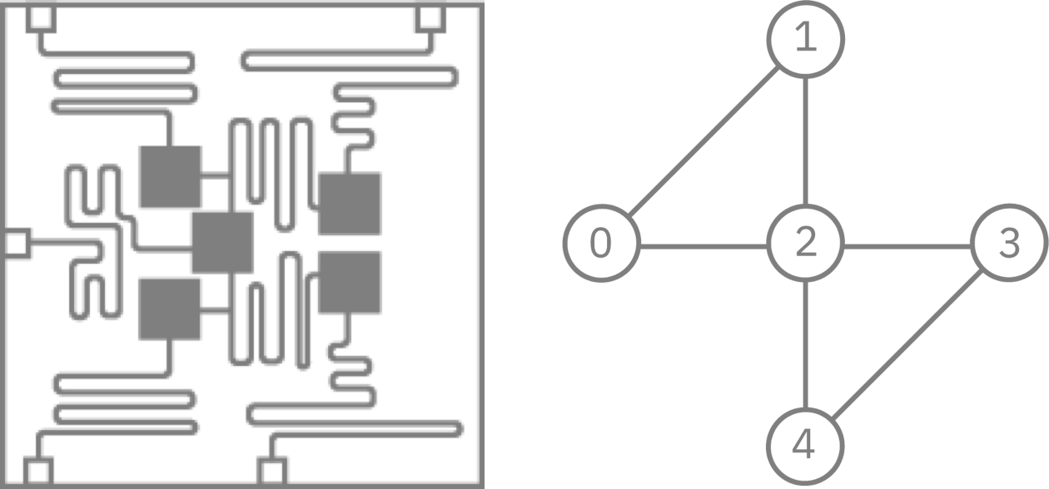
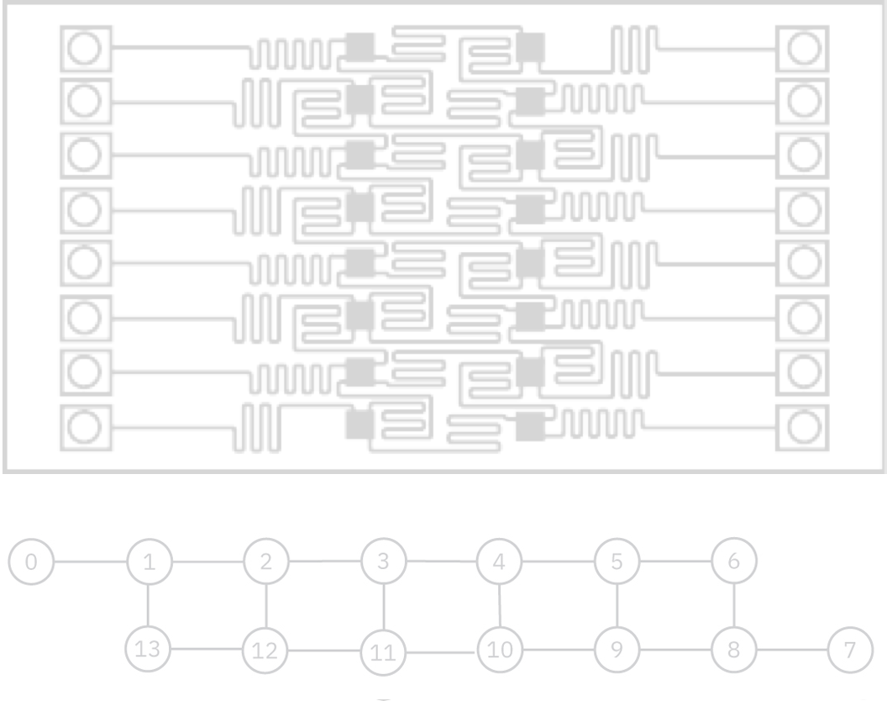
2. Computing with quantum mechanics
IBM Q: Noisy Intermediate Scale Quantum (NISQ) computers available online
IBM Q 5 Tenerife
IBM Q 5 Yorktown
IBM Q 14 Melbourne
Images from: https://www.research.ibm.com/ibm-q/technology/devices/

Slide 8
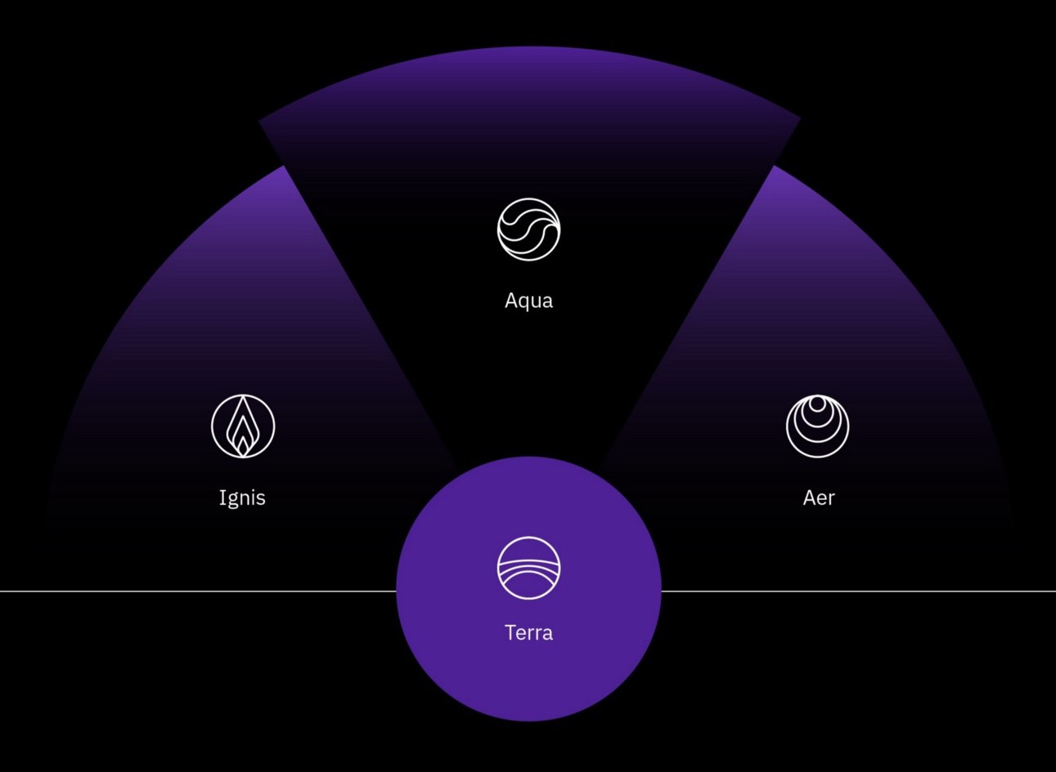
3. Qiskit: the language of quantum machines
Qiskit is a python-based software that allows anyone to experiment with quantum computation on a simulator or on one of IBM Q quantum computers.
Algorithms for chemistry, optimization, AI
Noise and errors
High-performance simulators
Image from: https://medium.com/qiskit/qiskit-and-its-fundamental-elements-bcd7ead80492
Foundation of quantum computing, compile circuits and interact with backends

Slide 9
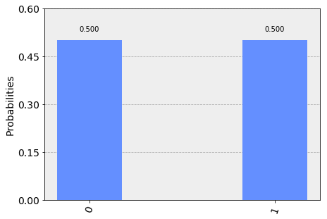
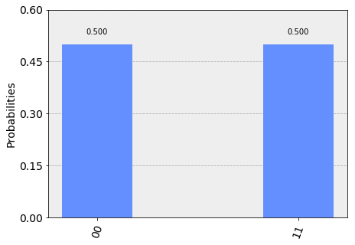
4. Quantum experiments on the cloud
Using Qiskit, you can carry out any quantum experiments you can think of. This can be used a pedagogical tool to experience the strangeness of quantum mechanics.
Observe the effects of:
superposition
entanglement
$$|ψ⟩=\frac{1}{\sqrt{2}}|0⟩+\frac{1}{\sqrt{2}}|1⟩$$
$$|ψ⟩=\frac{1}{\sqrt{2}}|00⟩+\frac{1}{\sqrt{2}}|11⟩$$
Images from: https://github.com/Qiskit/qiskit-tutorials/blob/master/community/terra/qis_intro/entanglement_introduction.ipynb
https://github.com/Qiskit/qiskit-tutorials/blob/master/community/terra/qis_intro/entanglement_introduction.ipynb

Slide 10
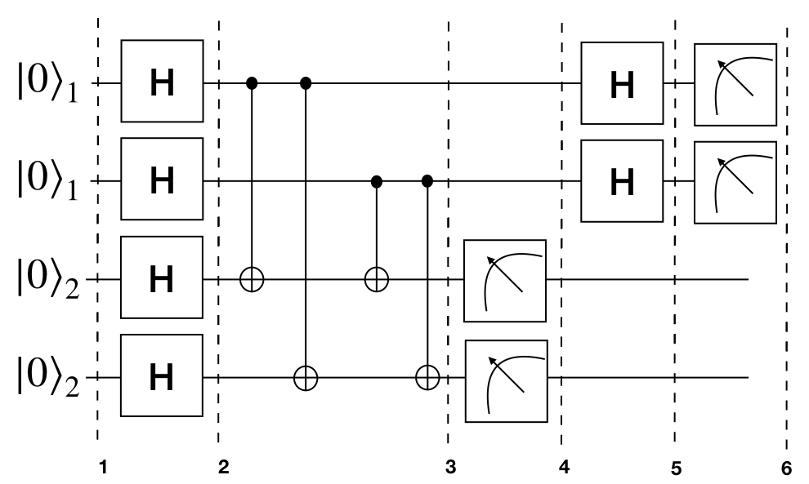
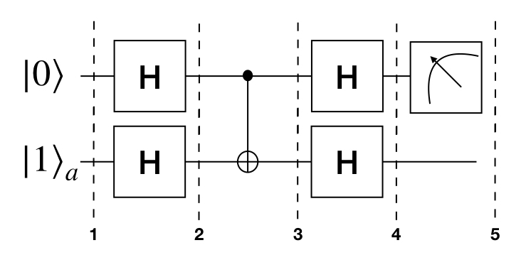
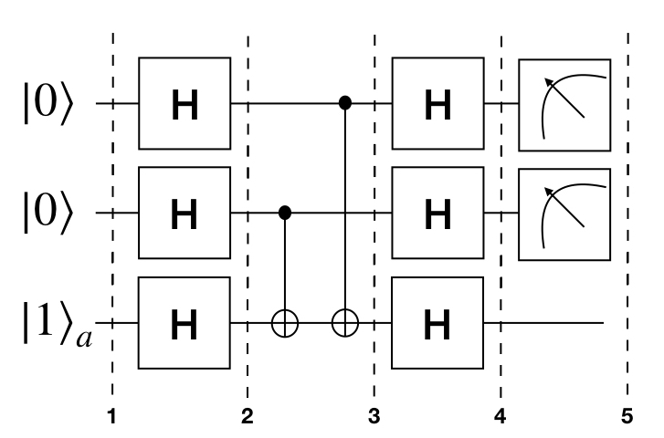
4. Quantum experiments on the cloud
Have a hands-on experience of the quantum algorithms that promise a quantum-advantage
Deutsch-Jozsa algorithm
Simon algorithm
Bernstein-Vazirani algorithm

Slide 11
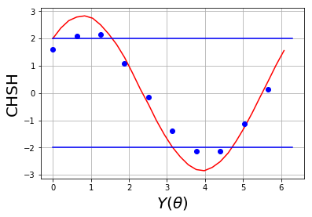
4. Quantum experiments on the cloud
Explore questions related to academic research. For instance, on the nature of quantum mechanics and its interpretations:
Bell theorem (CHSH inequality)
Experimental test of the validity of local vs non-local theories.
Local theories satisfy the CHSH inequality, non-local theories violate it.
Image from: https://github.com/Qiskit/qiskit-tutorials/blob/master/community/terra/qis_intro/entanglement_testing.ipynb

Slide 12
Thank you!

Slide 13
Miguel Ramalho

Slide 14
Regarding Quantum Education
Miguel Sozinho Ramalho
Qiskit Camp 2019
IBM Thomas J. Watson Research Center
February 26th

Slide 15
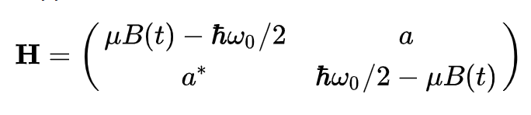
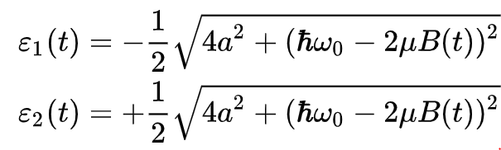
Basic Background Formulas Revision
Notes:
Hamiltonian for system with increasing energy (linear magnetic field)
Eigenvectors

Slide 16

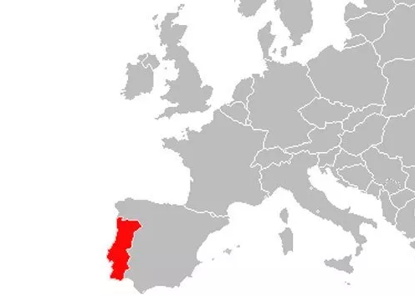

About Me
MSc in Computer Science and Engineering @ FEUP
Interests: Quantum Computing, Machine Learning, Competitive Programming, Behavioural Psychology, Open Source Projects, Exploring...

Slide 17
My Quantum Education
Est. 2018
TedX Talk by Prof. Koen Bertels
BerkleyX Quantum Mechanics and Quantum Computation
Lectures, books, surveys, forums, …
Started hacking around qiskit and IBMQX

Slide 18

Teach Me Quantum!

Slide 19
Food for thought
All or Nothing!
Turn problems into solutions…
How to capitalize the community?

Slide 20
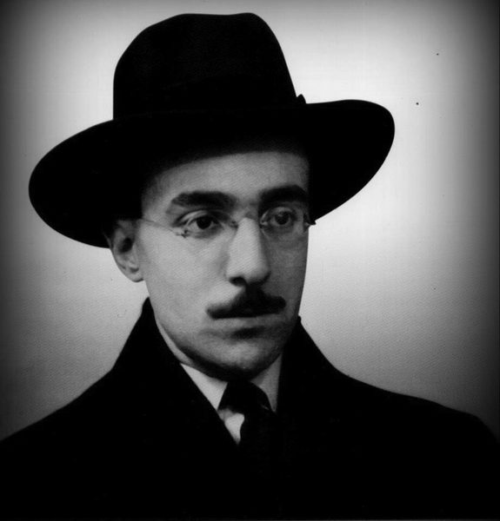
Put all that you are
into everything that you do.
Rougly translated Fernando Pessoa

Slide 21
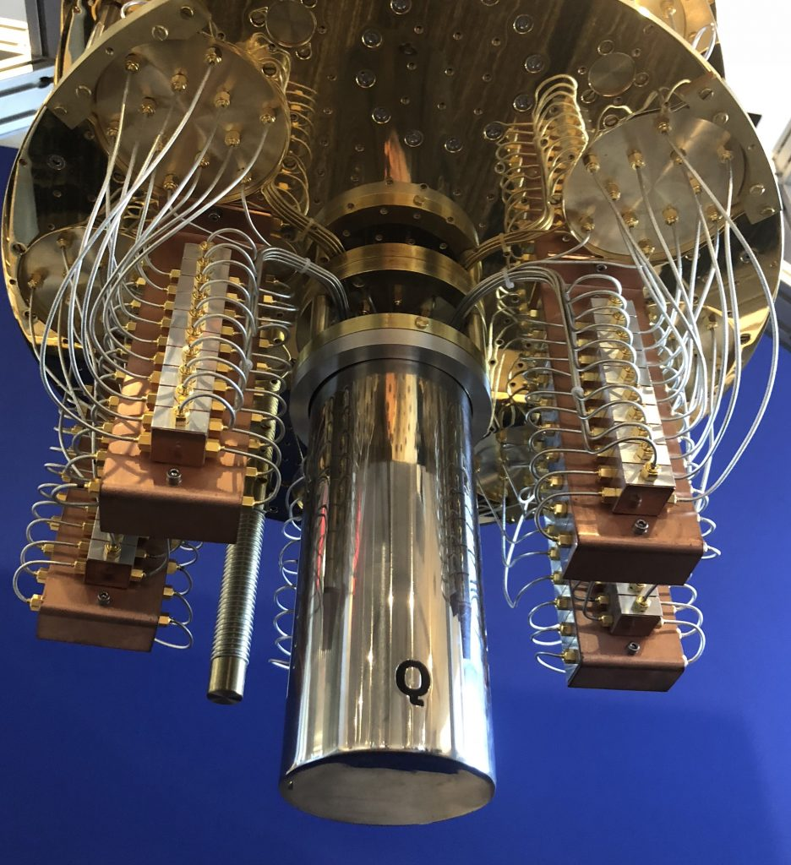

Thank you
Me
github.com/msramalho
linkedin.com/in/msramalho

Slide 22
Alwin Zulehner

Slide 23
Compiling quantum circuits to NISQ devices
Alwin Zulehner
Johannes Kepler University Linz, Austria
http://iic.jku.at/eda/research/ibm_qx_mapping
alwin.zulehner@jku.at

Slide 24
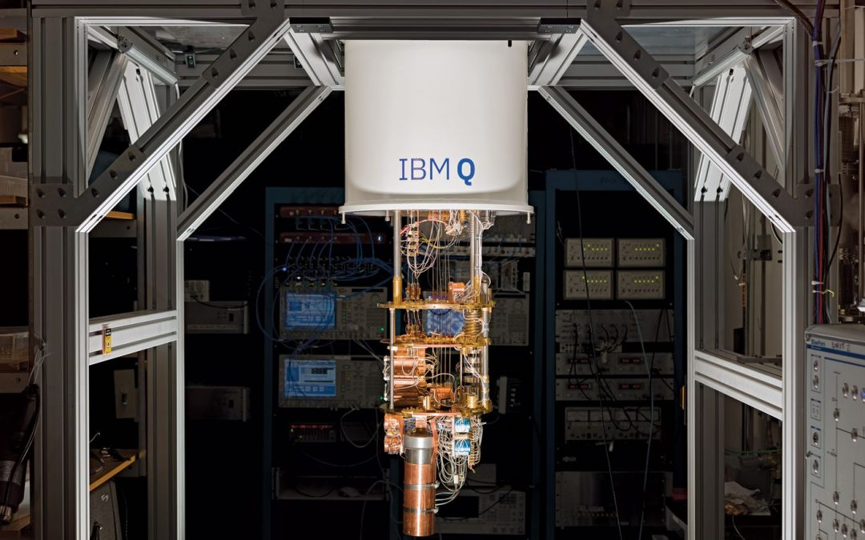
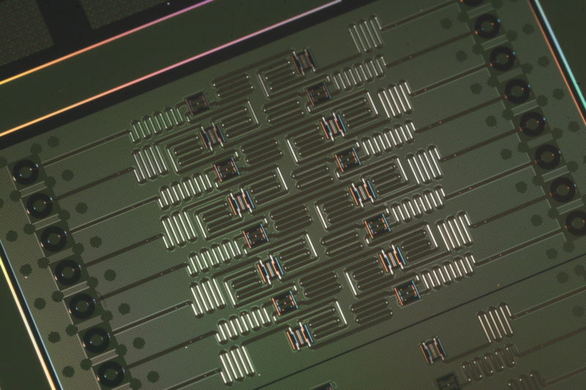
NISQ devices
NISQ = Noisy Intermediate-Scale Quantum
For example: IBM QX5
Available through cloud access
16 qubits (IBM QX5)
Single-qubit gate error:
Multi-qubit gate error:
Coherence time:

Slide 25
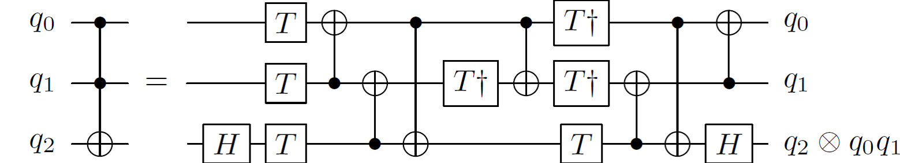
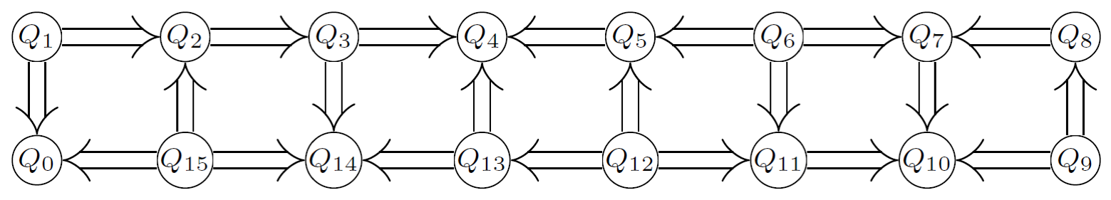
Compiling to NISQ Devices
Decomposition into elementary operations
Single qubit gates
Controlled Not (CNOT)
Example: Toffoli gate
Satisfying CNOT-Constraints
Given by the architecture

Slide 26
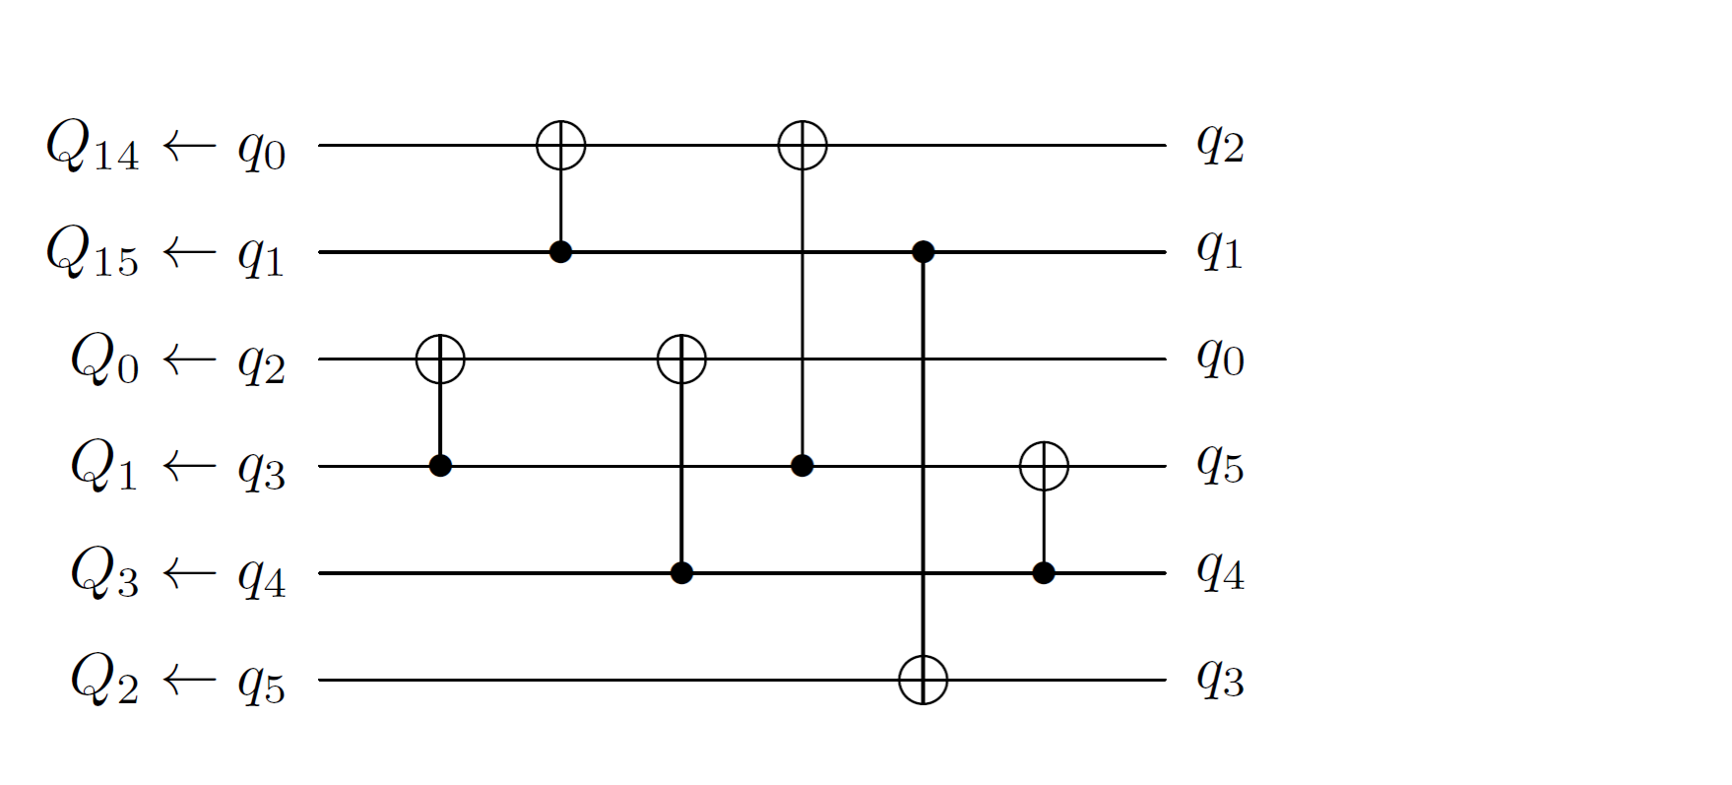
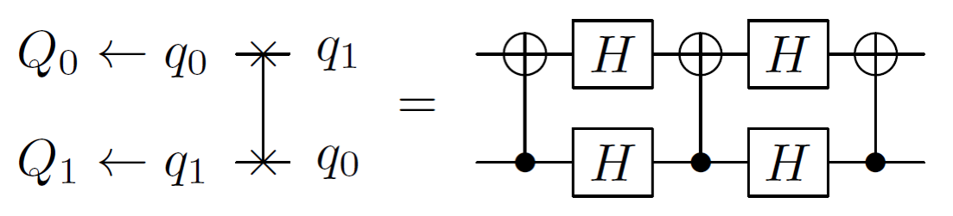
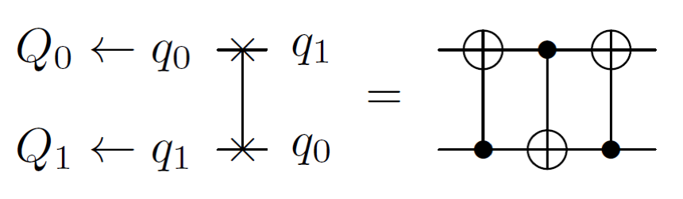
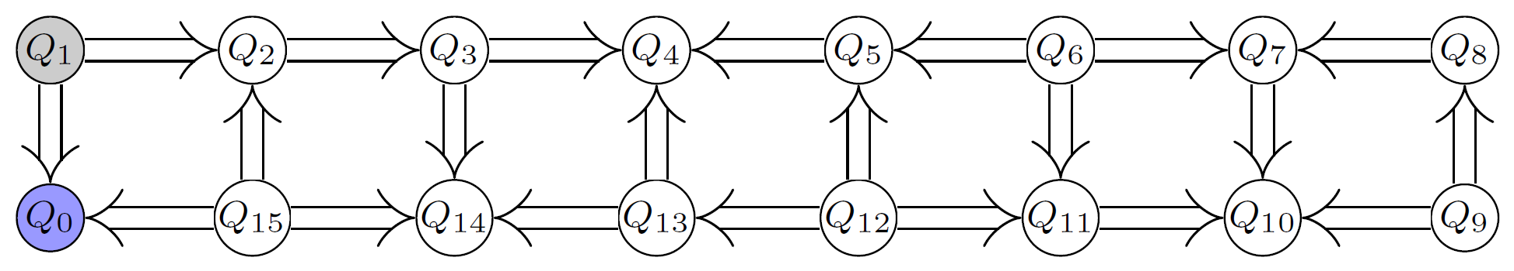
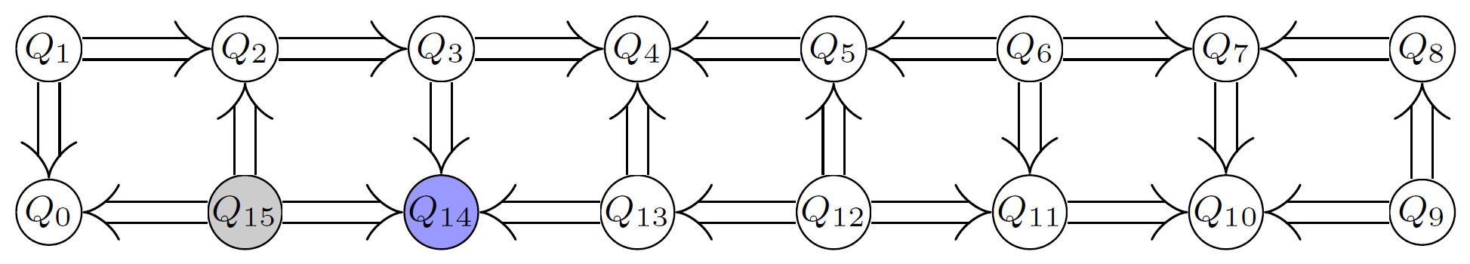
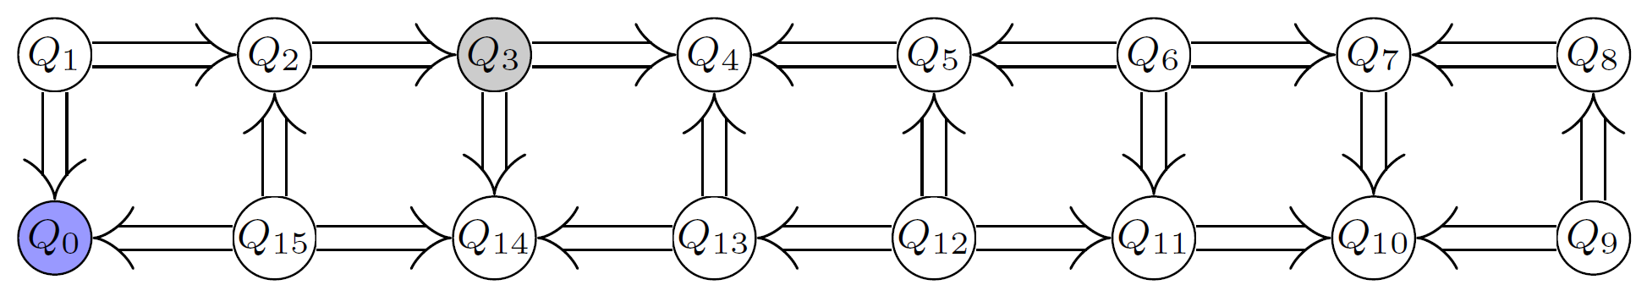
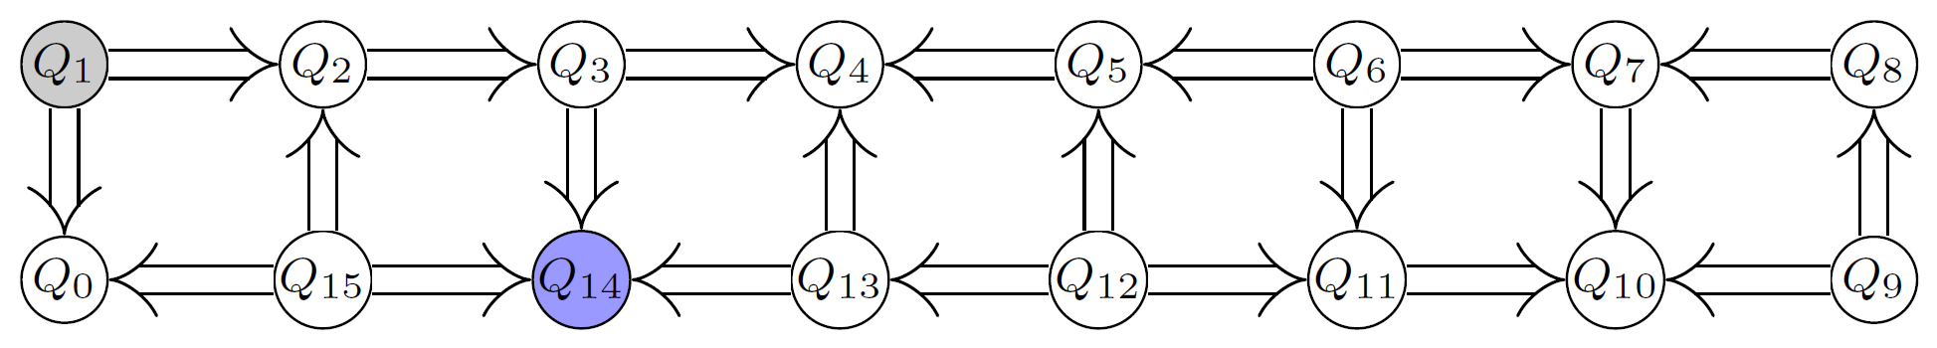
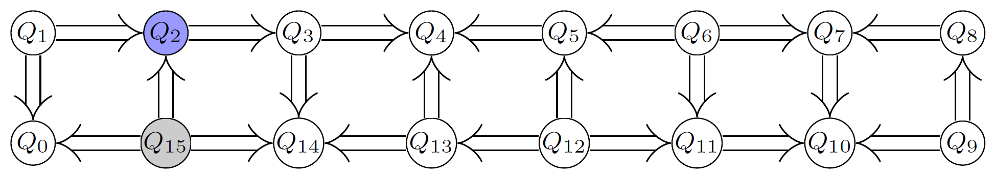
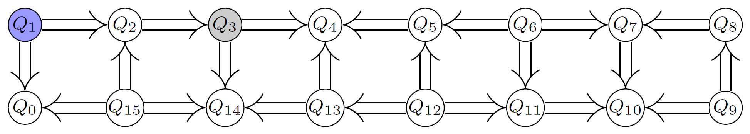
Satisfying CNOT-constraints
Map logic qubits to physical qubits
Usually not possible to find such a mapping
Mapping has to change dynamically
Insert SWAP gates
✓
✓
✗
✗
✗
✓

Slide 27
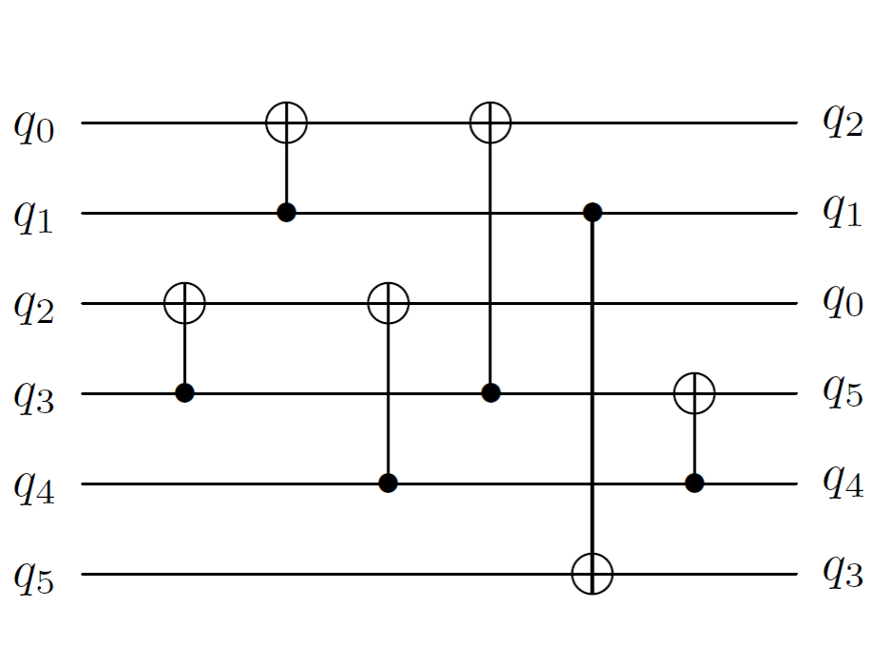
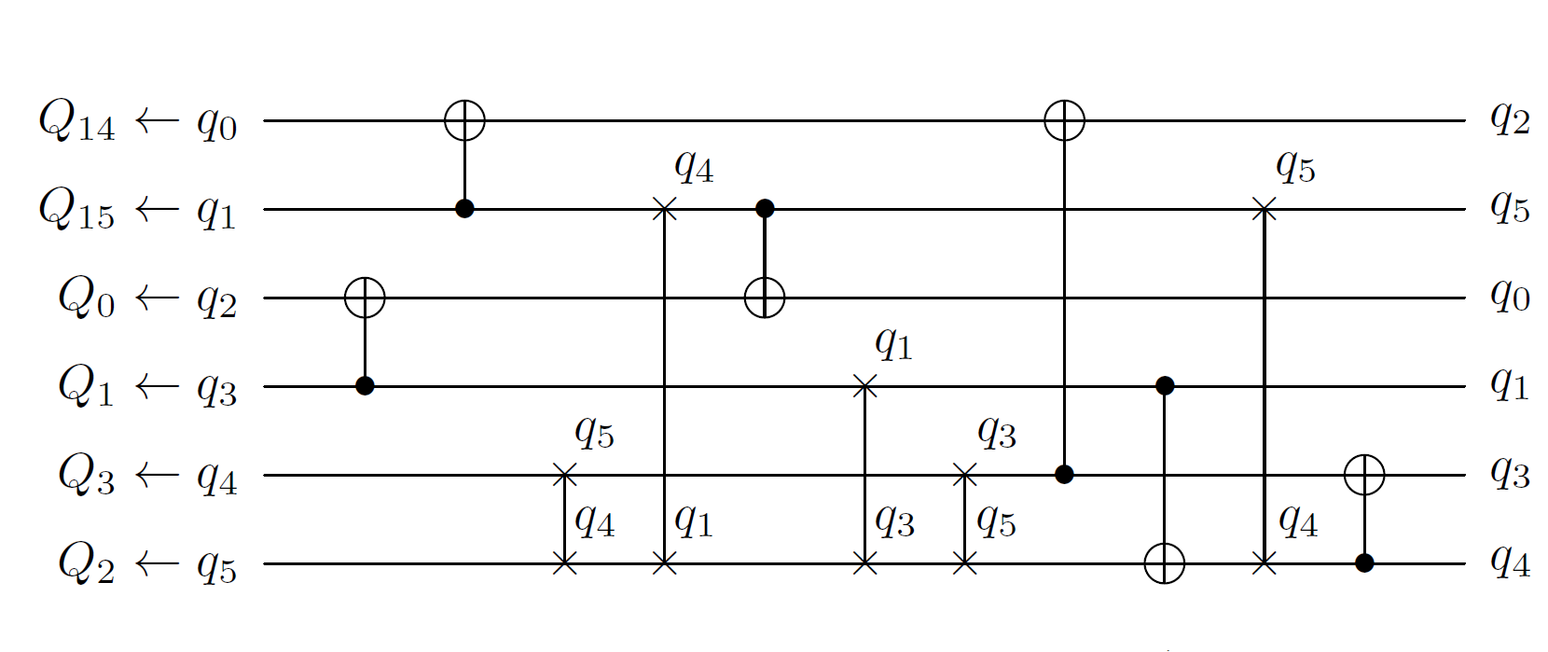
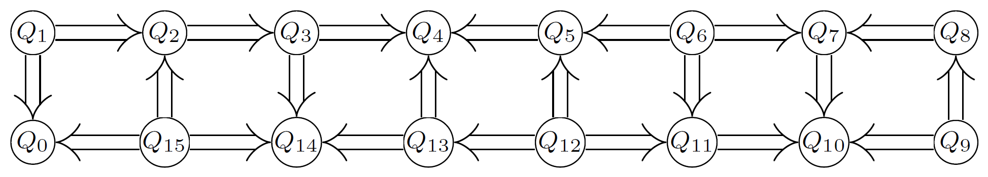
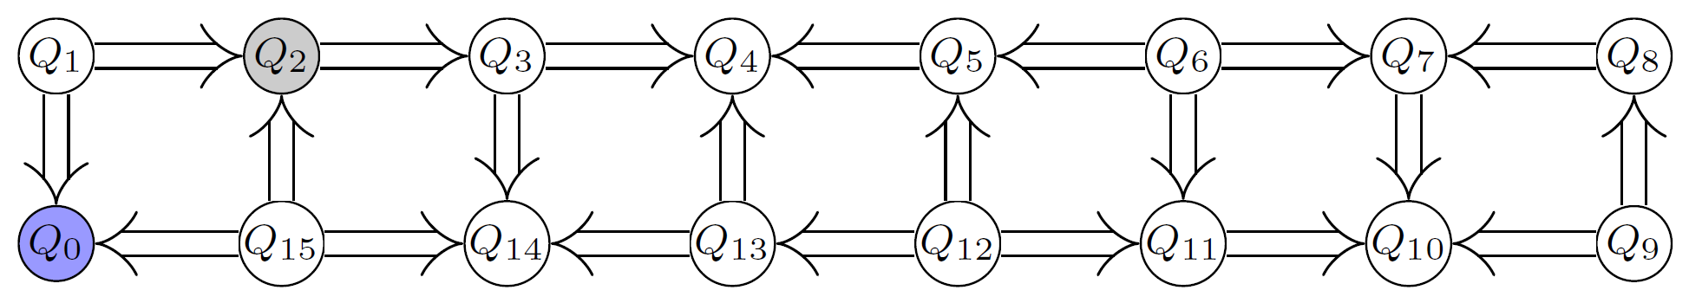
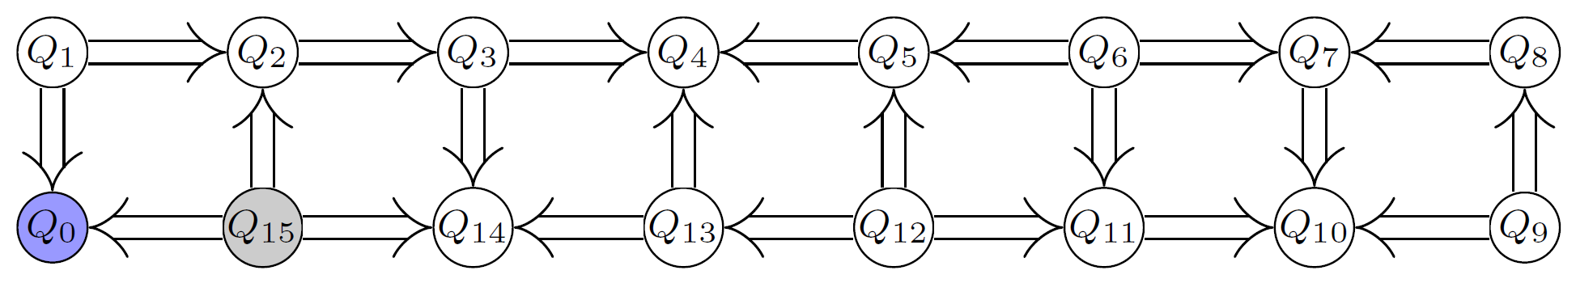
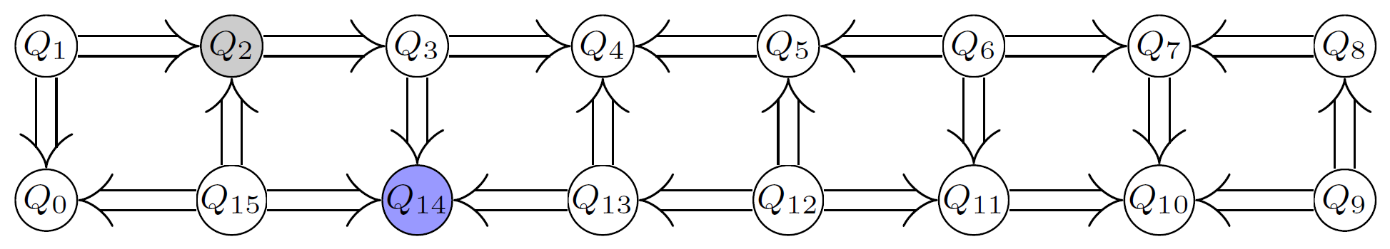
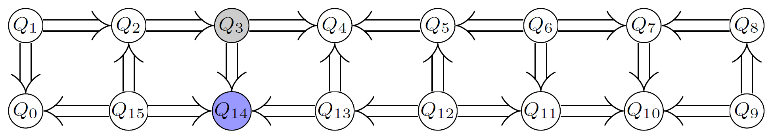
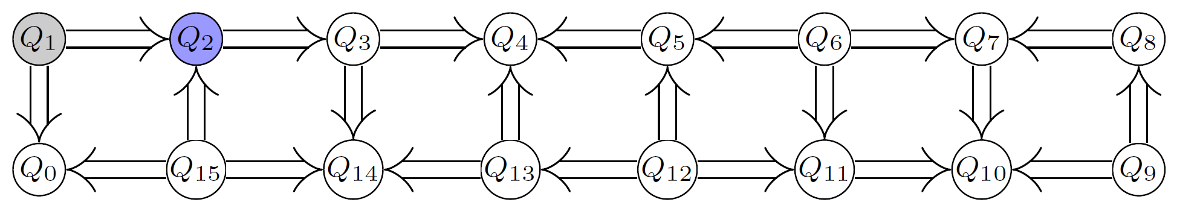
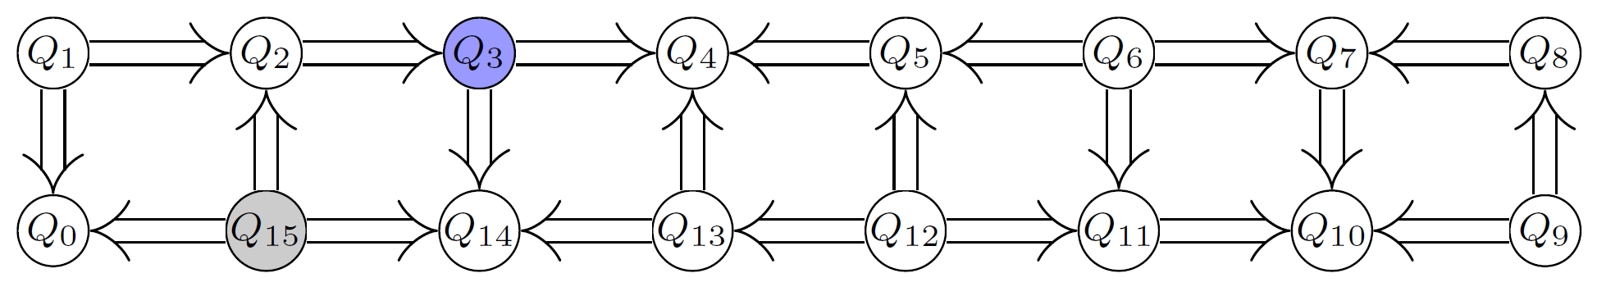
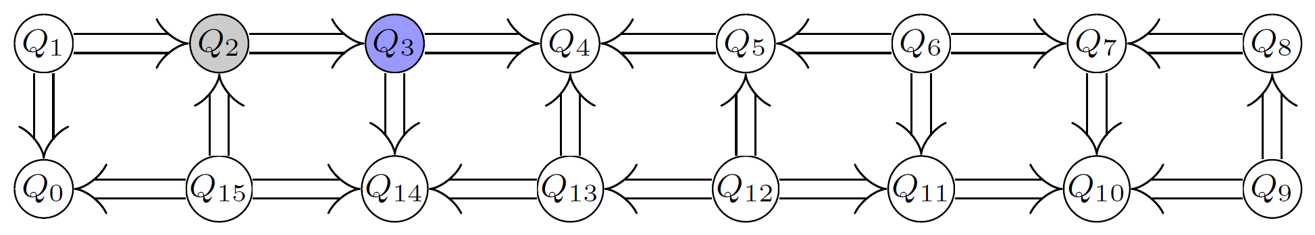
Naive Solution
Finding an optimal solution is NP-complete!

Slide 28
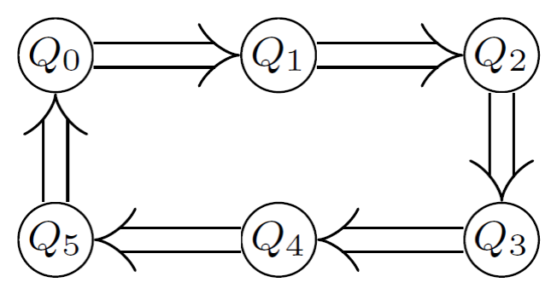
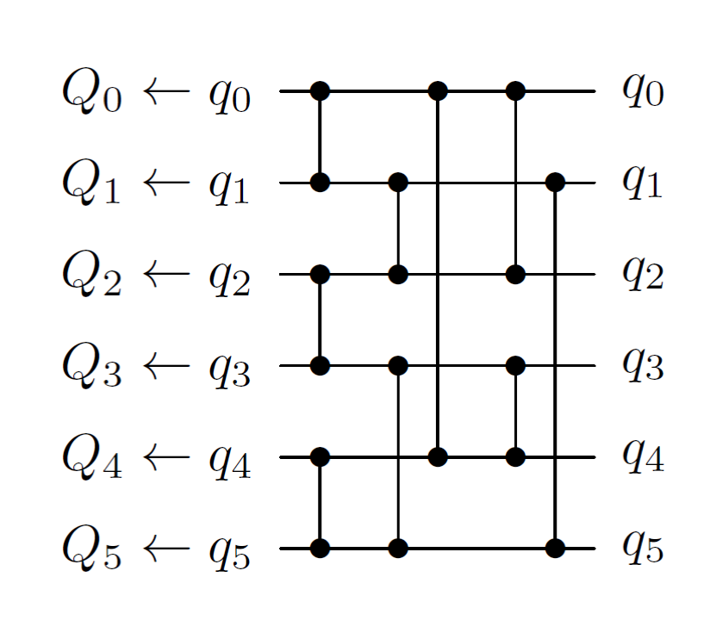
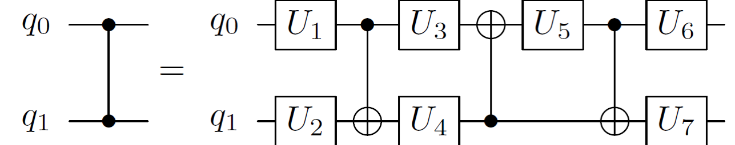
IBM QISKIT Developer challenge
Goal: optimize compiler regarding cost function
CNOT: 10
Single qubit gate: 1
Example architectures given by IBM
E.g. 6 qubit circular architecture
Random circuits as input
Each layer has 2-qubit gates
Gates are randomly sampled from SU(4)

Slide 29
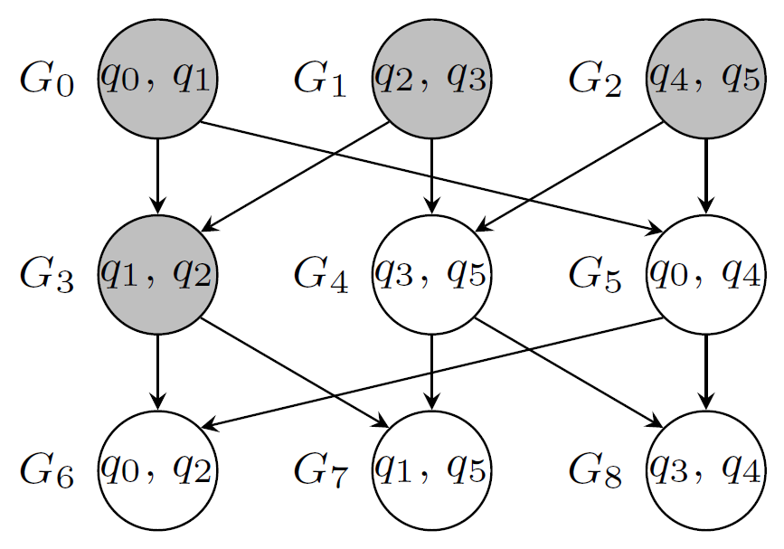
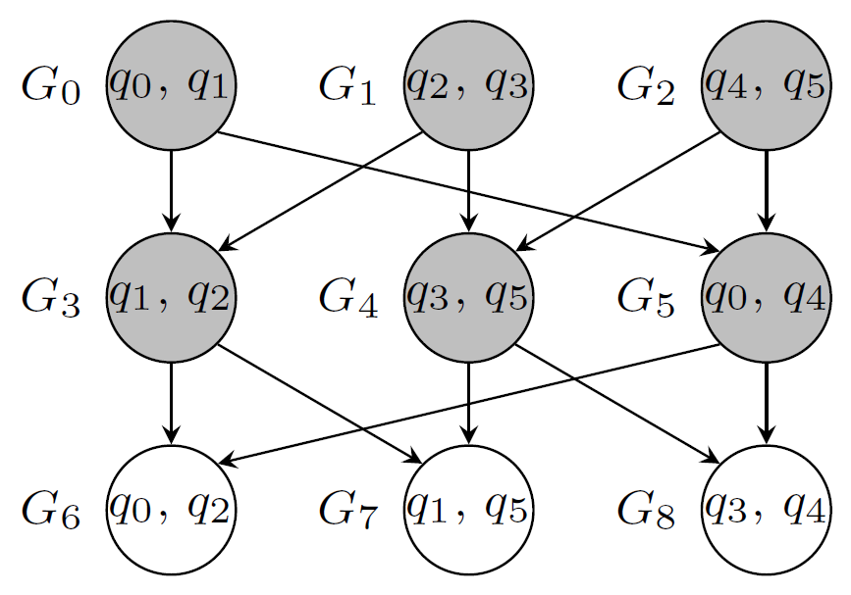
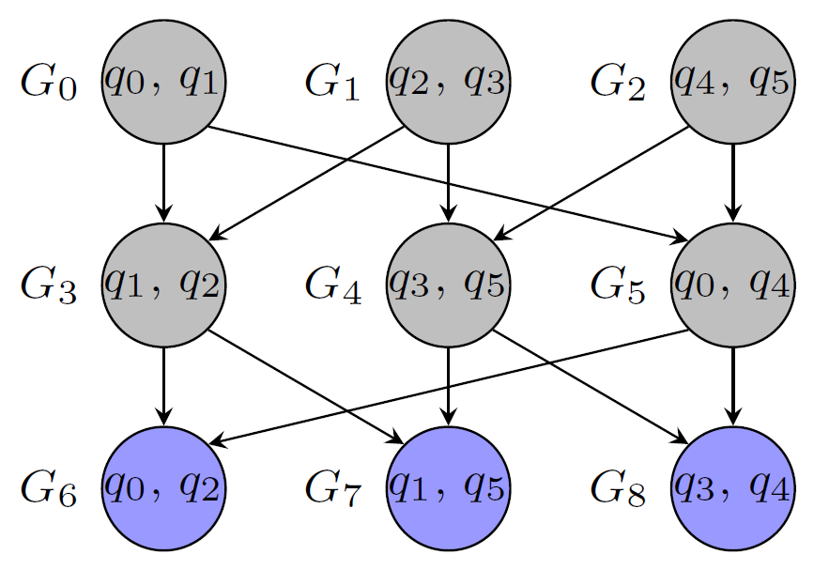
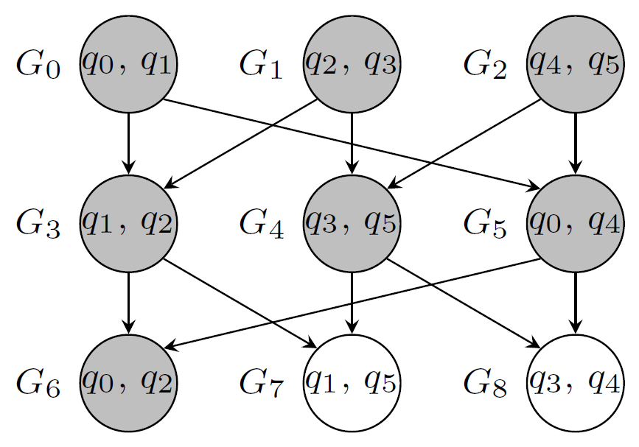
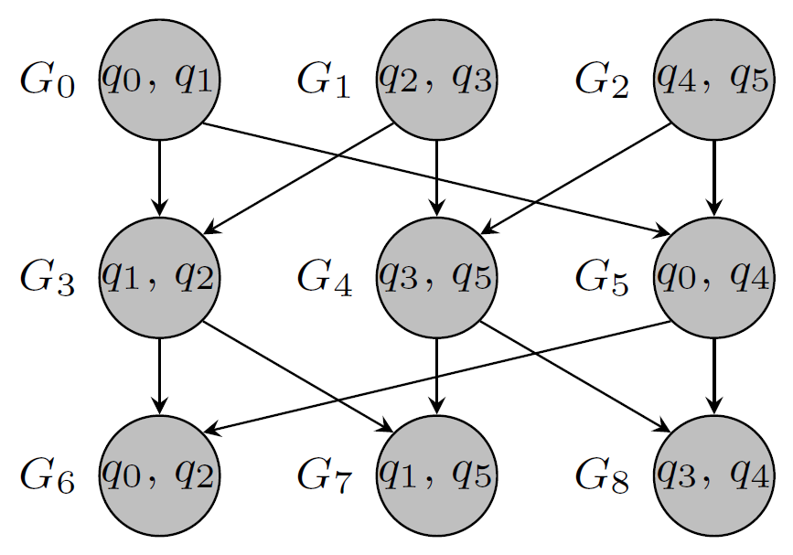





Dedicated Solution
Pre-processing:
Group gates that are applied to the same qubits
Map the gate groups (assume 6 qubit circular architecture)
Add groups for which the constraints are satisfied
Determine groups that can be applied
Find cheapest permutation with A* such that constraints are satisfied for at least one group
Post-mapping optimization
Re-group and Re-compile groups
Some SWAPs are for free!

Slide 30

Comparison to QISKit Compiler
Circuits and Architectures provided by IBM
Also significantly faster than the QISKit compiler (up to factor of 35)
More information in the paper “Compiling SU(4) Quantum Circuits to IBM QX Architectures”
Accepted and presented at ASP-DAC 2019
An implementation is publicly available at http://iic.jku.at/eda/research/ibm_qx_mapping

Slide 31




Further Directions
$$f:B^{n}→B^{m}$$
Synthesis of Boolean components for quantum computing
New one-pass design flow
Simulation of quantum circuits
Clever data-structures to handle exponential complexity
Currently integrated in Qiskit
Visit iic.jku.at/eda/research/quantum for further information
Embedding
$$f:B^{k}→B^{k}$$
Synthesis
Reversible Circuit
$$\left[\begin{aligned}0 \\ 0 \\ \frac{1}{2} \\ 0 \\ \frac{1}{2} \\ 0 \\ −\frac{1}{\sqrt{2}} \\ 0\end{aligned}\right]$$

Slide 32
Compiling quantum circuits to NISQ devices
Alwin Zulehner
Johannes Kepler University Linz, Austria
http://iic.jku.at/eda/research/ibm_qx_mapping
alwin.zulehner@jku.at

Slide 33
Sven Jandura

Slide 34


Slide 35


Slide 36


Slide 37


Slide 38


Slide 39


Slide 40


Slide 41


Slide 42


Slide 43


Slide 44


Slide 45


Slide 46


Slide 47


Slide 48


Slide 49


Slide 50


Slide 51


Slide 52


Slide 53


Slide 54


Slide 55


Slide 56


Slide 57


Slide 58


Slide 59


Slide 60


Slide 61


Slide 62
Eddie Schoute

Slide 63
Circuit Transformations for
Quantum Architectures
Andrew M. Childs, Eddie Schoute (QuICS, University of Maryland),
Cem M. Unsal (Department of Mathematics, University of Maryland)
2019-02-22
1

Slide 64
Goal
We want to find a time-efficient architecture-respecting circuit
transformation (a.k.a. “circuit mapping”) with low overhead, that is:
a mapping to a new circuit that preserves the function of the original
circuit
up to an initial mapping of circuit qubits to architecture qubits
the output circuit is constrained to respect the architecture
the output circuit is not much larger with respect to circuit depth or
size.
2

Slide 65
Prior Work
3 . 1

Slide 66
Non-scalable solutions
Hand-cra ed algorithms
Shor’s algorithm on Path graph (1D nearest-neighbor lattice)
Quantum Fourier Transform (QFT) on Path graph
Quantum Adders on Grid (nearest-neighbor square lattice)
Exponential-time
SAT solvers [Saeedi 2011]
Temporal planners [Venturelli 2018]
Satisfiability modulo theory [Murali 2019]
3 . 2

Slide 67
Non-scalable solutions
Hand-cra ed algorithms
Shor’s algorithm on Path graph (1D nearest-neighbor lattice)
Quantum Fourier Transform (QFT) on Path graph
Quantum Adders on Grid (nearest-neighbor square lattice)
Exponential-time
SAT solvers [Saeedi 2011]
Temporal planners [Venturelli 2018]
Satisfiability modulo theory [Murali 2019]
NP-hard to find one optimal placement of gates [Maslov 2007]
3 . 2

Slide 68

Heuristics
It is very common to break the circuit into layers of gates ( l 0 , l 1 , l 2 , … ).
Enables this simple circuit transformation where we repeat until done:
1. Run as many gates as possible
2. Permute qubits
[Metodi 2006, Hirata 2009, Wille 2016, Zulehner 2017, …] etc.
3 . 3

Slide 69
Routing and Bounds
Permuting qubits is a core question. Where and how?
Sorting networks provide bounds for arbitrary permutations [Kutin 2007,
Beals 2013, Brierley 2017]
3 . 4

Slide 70
Routing via Matchings
4 . 1

Slide 71

Intuitive Definition of Routing via Matchings
For graph G = (V , E ) and vertex unique destinations π : V ↔ V
(bijection), find minimum k such that we can implement π within k
parallel sets of SWAPs.
Each vertex v ∈ V has a token (or “packet”) that is routed to π (v ) .
Routing number [Alon 1994]:
rt(G, π ) := k ,
rt(G) := max rt(G, π ) .
π∈Sym(V )
Interpretation: Worst case number of parallel SWAPs to route any
π
on
G
4 . 2

Slide 72
Comparison Sorting to Routing
Graph
family
Sorting depth
(comparators)
Routing nr.
(transpositions)
path (Pn ) n [Knuth 1998] n [Alon 1994]
complete
(K n )
⋮ (see
paper)
Θ(log n)
[Ajtai1983]
⋮
2
[Alon1994]
⋮
We can do much better than sorting networks!
4 . 3

Slide 73
Token Swapping
Routing via matchings minimizes the number of parallel SWAP steps.
Token swapping minizes the total number of SWAPs.
4 . 4

Slide 74
Token Swapping
Routing via matchings minimizes the number of parallel SWAP steps.
Token swapping minizes the total number of SWAPs.
Use this to optimize for circuit size!
4 . 4

Slide 75
Partial Routing via
Matchings
5 . 1

Slide 76
Motivation
We frequently wish to move only a few qubits (those involved in two-
qubit gates).
⟹ Allow vertices to have undefined destinations.
5 . 2

Slide 77
Partial Routing
We extend routing via matchings, token swapping, and the routing
number to support a partially defined destination map π .
We call these partial routing via matchings and partial token swapping.
The destination is unconstrained for v ∈/ domain(π ) .
5 . 3

Slide 78
Base Cases
Extended [Alon 1994] results to partially defined destinations
Path: rt(Pn ) ≤ n
Complete Graph:
rt(K n ) = 2
5 . 4

Slide 79
Hierarchical Product
We provide a routing algorithm for a quite general graph family called the
(generalized) hierarchical product [Barriere 2009].
Special cases of the hierarchical product:
Cartesian Product: G1 × G2 =
Rooted product: Π e i (G1 , G2 )
Π 1 (G1 , G2 )
Modular quantum architecture: Π e 1 (K n1 , K n2 )
5 . 5

Slide 80

Example of a Modular Architecture
Modular architecture Π e 1 (K 4 , K 4 ) .
5 . 6

Slide 81

Simplified Example of Routing
Three copies of the graph G2 connected via one G1 ( Π e 1 (G1 , G2 ) ). Each
token has a “destination G2 ” inferred from π : V ⥎V .
5 . 7

Slide 82

The setup.
Round 1.
5 . 8

Slide 83

We move tokens to the
G
1
using the routing algorithm for
G
2
.
You can see this will be fairly trivial.
5 . 9

Slide 84

The tokens are already at their destination so we are done.
We remove the tokens.
5 . 10

Slide 85

We move tokens to the
G
1
such that destinations are unique.
Now we route…
5 . 11

Slide 86

Since destinations are unique, the routing on G1 is a permutation so we
can use the (partial) routing via matchings algorithm for routing on G1 .
5 . 12

Slide 87

Tokens are at destinations so we remove them.
Next up is round 3.
5 . 13

Slide 88

Move tokens to
G
1
. This time we need a token with unconstrained
destination to ensure all destinations are unique.
5 . 14

Slide 89

We use the partial routing via mathcings algorithm on G1 to route. We
use that x is unconstrained to be able to route.
5 . 15

Slide 90

We remove the tokens that were routed.
Next is round 4.
5 . 16

Slide 91

Move tokens to
G
1
.
We include the unconstrained token, but this is not necessary.
5 . 17

Slide 92

And we are done since routing was trivial.
In a total of 4 rounds.
5 . 18

Slide 93
Theorem: Routing on Hierarchical Products
⌉
degree(π)
⌉
rt(Π v (G1 , G2 ), π ) ≤
(rt(G1 ) +
rt(G2 )) + rt(G2 )
hamming(v)
#rounds
where
degree(π )
equals the maximum number of tokens leaving or
entering a copy of G2 .
5 . 19

Slide 94
Lower Bound on Hierarchical Products
We also show a lower bound of
⌈
degree(π )
hamming( v )
⌉
2
−
1 ≤ rt(Π v (G1 , G2 , ), π ) ,
which is tight up to the -1 in some cases.
5 . 20

Slide 95

Minimizing Total Transpositions
We also generalize a 4-approximation routing algorithm [Miltzow 2016]
for minimizing the total number of transpositions to partial
permutations.
Given graph G = (V , E ) and π : V ⥎V , the
generalized algorithm uses at most
transpositions.
4⋅rs(G, π )
rs(G, π ) , the routing size , is the smallest number of transpositions along
E to implement π .
5 . 21

Slide 96
Architecture-Respecting
Circuit Transformations
6 . 1

Slide 97
A simple recipe
Ingredients:
A routing algorithm for implementing partial permutations.
An algorithm for finding an assignment of circuit qubits to architecture
qubits.
6 . 2

Slide 98
Let
Q
be the qubits of the input circuit, and
architecture.
V
the vertices (qubits) of the
6 . 3

Slide 99
Let
Q
be the qubits of the input circuit, and
architecture.
Now repeat:
V
the vertices (qubits) of the
6 . 3

Slide 100
Let
Q
be the qubits of the input circuit, and
architecture.
Now repeat:
V
the vertices (qubits) of the
1. Execute as many gates as possible
6 . 3

Slide 101
Let
Q
be the qubits of the input circuit, and
architecture.
Now repeat:
V
the vertices (qubits) of the
1. Execute as many gates as possible
2. Use the placement algorithm to find a new placement,
qubits to vertices
p : Q⥎V
, of
6 . 3

Slide 102
Let
Q
be the qubits of the input circuit, and
architecture.
Now repeat:
V
the vertices (qubits) of the
1. Execute as many gates as possible
2. Use the placement algorithm to find a new placement,
qubits to vertices
p : Q⥎V
, of
3. Use the routing algorithm to construct a circuit implementing the
partial permutation p ∘ p^−1 : V ⥎V
6 . 3

Slide 103
Let
Q
be the qubits of the input circuit, and
architecture.
Now repeat:
V
the vertices (qubits) of the
1. Execute as many gates as possible
2. Use the placement algorithm to find a new placement,
qubits to vertices
p : Q⥎V
, of
3. Use the routing algorithm to construct a circuit implementing the
partial permutation p ∘ p^−1 : V ⥎V
p^ : Q → V is the (injective) current placement of qubits on vertices.
6 . 3

Slide 104
Placing Qubits on the
Architecture
7 . 1

Slide 105
Strategies
By gate placement cost: Highest or lowest first
Constrained to maximum matchings or not
Place as many gates as possible—possibly at high cost—or fewer
Partially move qubits of a gate closer
Use rt(⋅ ) for depth or rs(⋅ ) for size. (Note: We approximate these
theoretical quantities with our permuters)
Lookahead (slow)
7 . 2

Slide 106
Example 1: Simple Size Mapper
Try to minimize the size overhead by the strategy:
Lowest placement cost gate first
All edges allowed
Place only one gate
Use rs(⋅) to compute the cost in size overhead
7 . 3

Slide 107
Example 1: Simple Size Mapper
Try to minimize the size overhead by the strategy:
Lowest placement cost gate first
All edges allowed
Place only one gate
Use rs(⋅) to compute the cost in size overhead
Specifically, place just the lowest-cost two-qubit gate at lowest-cost edge
) ,
min
(q1 ,q2 )∈tg(L)
min
(v1 ,v2 )∈E
rs(G, (p + {q1
↦ v1 , q2
↦ v2 }) ∘ p^−1
where p ∘ p^−1 : V ⥎V is a partial permutation
7 . 3

Slide 108
Example 2: Greedy Depth Mapper
Try to minimize the depth overhead by placing:
the gate with highest cost placement first (“minimizing makespan”)
only on the maximum matching edges
as many gates as possible
M ⊆ E
use rt(⋅) to compute the cost in depth overhead
7 . 4

Slide 109
Example 2: Greedy Depth Mapper
Try to minimize the depth overhead by placing:
the gate with highest cost placement first (“minimizing makespan”)
only on the maximum matching edges
as many gates as possible
M ⊆ E
use rt(⋅) to compute the cost in depth overhead
Specifically, iterate finding a gate and placement that attains
max min rt(G, (p + {q1 ↦ v1 , q2 ↦ v2 }) ∘ p^−1 ) .
(q1 ,q2 )∈tg(L) (v1 ,v2 )∈M
7 . 4

Slide 110
Results
8 . 1

Slide 111
Weighting Gates
Depending on the hardware, some gates may take more time, or
introduce more noise.
We pick unit cost for single-qubit gates, 10 for CNOTs, and 30 for SWAP
gates.
8 . 2

Slide 112

8 . 3

Slide 113

8 . 4

Slide 114
Conclusion
9 . 1

Slide 115
Summary
Formalized notions of partial routing
Generalized to hierarchical product of graphs
Tried various strategies for placing qubits
Gave simple construction for architecture-respecting circuit
transformation from permuter & mapper
Built so ware tool for transforming quantum circuits
Tested empirical performance of our circuit transformations.
9 . 2

Slide 116
Summary
Formalized notions of partial routing
Generalized to hierarchical product of graphs
Tried various strategies for placing qubits
Gave simple construction for architecture-respecting circuit
transformation from permuter & mapper
Built so ware tool for transforming quantum circuits
Tested empirical performance of our circuit transformations.
Open questions
How can we improve our mapper placement strategies?
Can we predict which circuit transformations or architectures will
perform well?
Is routing using only SWAPs optimal?
9 . 2

Slide 117
Summary
Formalized notions of partial routing
Generalized to hierarchical product of graphs
Tried various strategies for placing qubits
Gave simple construction for architecture-respecting circuit
transformation from permuter & mapper
Built so ware tool for transforming quantum circuits
Tested empirical performance of our circuit transformations.
Open questions
How can we improve our mapper placement strategies?
Can we predict which circuit transformations or architectures will
perform well?
Is routing using only SWAPs optimal?
Thank you for your attention
9 . 2

Slide 118
Alex Pozas-Kerstjens

Slide 119


Slide 120


Slide 121


Slide 122


Slide 123


Slide 124


Slide 125


Slide 126


Slide 127


Slide 128


Slide 129


Slide 130


Slide 131


Slide 132


Slide 133


Slide 134


Slide 135


Slide 136


Slide 137


Slide 138


Slide 139


Slide 140


Slide 141


Slide 142


Slide 143


Slide 144


Slide 145
Christophe Vuillot

Slide 146


Slide 147


Slide 148


Slide 149


Slide 150


Slide 151


Slide 152


Slide 153


Slide 154


Slide 155


Slide 156


Slide 157


Slide 158


Slide 159


Slide 160
Clément Javerzac-Galy

Slide 161


Slide 162


Slide 163


Slide 164


Slide 165


Slide 166


Slide 167


Slide 168


Slide 169


Slide 170


Slide 171


Slide 172


Slide 173


Slide 174


Slide 175


Slide 176


Slide 177


Slide 178


Slide 179


Slide 180


Slide 181


Slide 182


Slide 183


Slide 184


Slide 185


Slide 186


Slide 187


Slide 188


Slide 189


Slide 190


Slide 191


Slide 192


Slide 193


Slide 194


Slide 195


Slide 196


Slide 197


Slide 198


Slide 199


Slide 200


Slide 201


Slide 202


Slide 203


